Slide 1
Introduction to The State of New Jersey Department of Human Services Commission for the Blind and Visually Impaired

Slide 2
Mission Statement
The mission of the New Jersey Commission for the Blind and Visually Impaired is to promote and provide services in the areas of education, employment, independence and eye health through informed choice and partnership with persons who are blind or visually impaired, their families and the community.

Slide 3
CBVI’s Consumer Centered Service Programs
Consumer
Vocational Rehabilitation
Education
Better Eye Health Services and Treatment
Independent Living
Notes:
Picture of interlocking circles labeled Vocational Rehabilitation, Independent Living, Education and Project BEST surrounding the center circle, labeled the consumer

Slide 4
Did you know?
That if you are blind, visually impaired or deaf blind, the Commission for the Blind and Visually Impaired may be able to assist you with:
Vocational Rehabilitation Services to help you become employable and obtain employment
Education Services, when approved by your school district, to help you succeed in your local public school program
Rehabilitation Teaching to enable you to manage your household and perform tasks of daily living with impaired vision
Orientation and Mobility Instruction to assist you in traveling independently
Eye Health Services and related instruction for self-care with insulin injections, etc.

Slide 5
Eligibility for CBVI Services
A person may be eligible for services if he or she is experiencing a vision impairment that is affecting his or her ability to perform normal daily life activities.
Notes:
Caricature photos of a child doing homework, a smiling woman with household cleaning equipment and people reading newspapers.

Slide 6
Application/Referral Procedure
To apply or refer someone for services call :
877-685-8878 or 973-648-3333
and you will be referred to a local CBVI service center.
Please be prepared to provide the following information:
Applicant's name, telephone number and Social Security number
Applicant's address, including county of residence and zip code.
It would also be helpful if you are able to provide:
Description of applicant's vision impairment
° Name and address of the applicant’s eye care professional

Slide 7
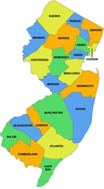
Regional Office Information
Newark Regional Office:
Serving: Bergen, Essex, Hudson, Morris, Passaic, Sussex, and Warren counties
Address: 153 Halsey Street 5th fl. Newark, NJ 07101 Phone: 973-648-2111
Administrator: Aaliyah Dent Aaliyah.Dent@dhs.nj.gov
Send eye examination reports to: CBVI-ER-NRO@dhs.nj.gov
Central Regional Office
Serving: Hunterdon, Middlesex, Monmouth, Ocean, Somerset, and Union counties
Address: 100 Daniels Way, Freehold, NJ 07728 Phone: 732-308-4001
Administrator: John Reiff John.Reiff@dhs.nj.gov
Send eye examination reports to: CBVI-ER-CRO@dhs.nj.gov
Southern Regional Office
Serving: Atlantic, Burlington, Camden, Cape May, Cumberland, Gloucester, Mercer and Salem counties
Address: 2201 Route 38 East, Suite 600 Cherry Hill, NJ 08002 Phone: 856-482-3700
Administrator: Diana Cortez Diana.Cortez@dhs.nj.gov
Atlantic City Satellite Office –
Address: 1300 Atlantic Avenue 3rd Floor, Atlantic City, NJ 08401 Phone: 609-441-3074
Send eye examination reports to: CBVI-ER-SRO@dhs.nj.gov
(PICTURE: NJ County Map)
)

Slide 8
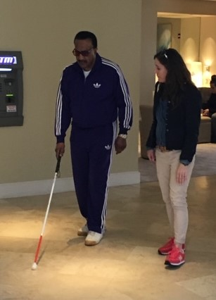
Independent Living Services
In Home Instruction in Daily Living Skills
Instruction for Safe Independent Travel
Child Care Skills
Instruction in Communication Methods
Referral to Community Resources

Slide 9
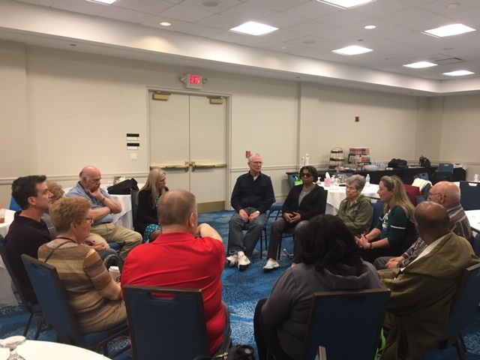
Aspire Assistive Support Programs for Independence, Renewal, and Education
ASPIRE is a statewide network of peer support groups that provide individuals who are living with vision loss the opportunity to gain the necessary coping skills, information, and education needed to thrive.
ASPIRE is administered by the Independent Living Unit of CBVI, and is geared towards people with vision loss 55 years or older, but is also available to all adults interested in attending
ASPIRE offers individuals with vision loss the opportunity to connect with others who share similar challenges and the same life experiences
There are 68 peer led groups throughout all 21 NJ Counties, including 4 groups specifically for veterans and 2 groups for people who are deaf-blind.
Picture: group of people sitting in chairs in a circle having a meeting.

Slide 10
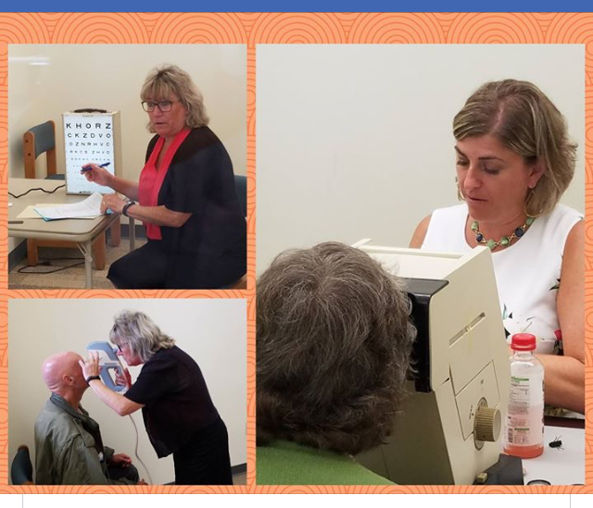
PROJECT B.E.S.T. (Better Eye Health Services and Treatment)
Diabetes Eye Disease Detection Program
Other specialized no cost eye screening programs which target minorities, the elderly and migrant farm workers
On site screenings at community based venues, including health fairs and federally qualified health centers
Vision screenings for preschool and school age children and those with special needs.
Referral for resources for eye health care
(Picture: (3) eye chart with woman, woman checking man’s eye pressures, woman checking another woman’s eyes

Slide 11
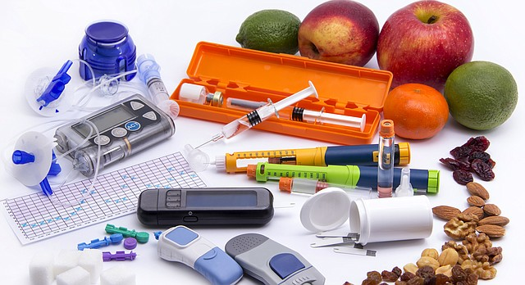
CBVI Eye Health Nurses
Provide:
Diabetes Education
Instruction on Adaptive Equipment/Devices (insulin syringes, talking glucose monitors)
Nutritional Advice
Monitor Health Care

Slide 12
Blindness Education Program
Collaboration with Local School Districts
Comprehensive Itinerant Services Provided by Teachers of the Blind and Vision Impaired
Focused on Inclusion, Integration and Mainstreaming (Known nationally as “The New Jersey Plan)

Slide 13
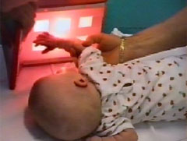
Infant Services (birth to age 3)
CBVI provides statewide itinerant education for infants and toddlers (birth to age 3), who are blind, vision impaired, deaf-blind, or multi-disabled with a significant vision impairment and their families. Disability-specific services are provided in the child’s natural environment.

Slide 14
Vocational Rehabilitation Services (VR)
Evaluation
Counseling and Guidance
Training
Job Placement
Post-Employment
Supported Employment
College Counseling/Support
High School Transition
Business Enterprises
Entrepreneurial Program
Joseph Kohn Training Center

Slide 15
High School Transitional Services
Serves high school students (14 – 21)
Career assessment, planning and training
Includes summer career exploration and college preparatory programs

Slide 16
College Services
CBVI may assist college students with:
Funding Resources
Counseling
Guidance
Advocacy
Job Placement

Slide 17
Joseph Kohn Training Center (JKTC)
Instruction Areas Include:
Activities of Daily Living Skills Instruction
Orientation and Mobility Instruction
Kitchen Skills
Communication Skills
Braille
Assistive Technology Skills

Slide 18
Joseph Kohn Training Center (JKTC)
Program also includes:
Vocational Counseling
Career Assessment
Adjustment to Vision Loss Counseling
Psychological Services
Social Services
Community-based work experience

Slide 19
Business Enterprises New Jersey (BENJ)
CBVI administers the federal Randolph-Sheppard Program
NJ currently has 54 locations managed by individuals who are legally blind
Locations include: Snack Bars, Cafes/cafeterias, and vending machine locations

Slide 20
Assistive Technology Services (Access Tech)
CBVI offers:
Recommendations for assistive technology for people who are blind, vision impaired or deaf blind
Solutions and tips for daily living
In-depth training to help you get the most out of your technology
Equipment demonstrations in our Regional Assistive Technology Centers (R-TACs)
Workplace, classroom or other location visits to assess lighting and equipment placement
The opportunity for individuals to test different options and solutions

Slide 21
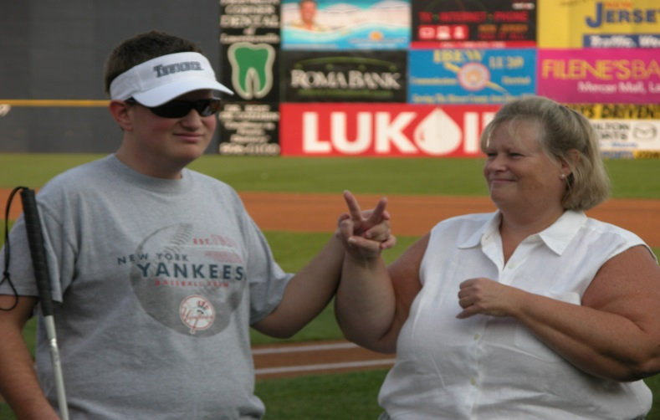
Deaf Blind Services
Assists Individuals who are Deaf Blind or both hearing and vision impaired, their parents, counselors, educators, employers and the community through various services:
Provision of Functional Vision Assessments
Participation in Educational Planning
Employment Counseling and Training
Assessments and Provision of Specialized Adaptive Equipment
Community Integration Support
In-Service Presentations

Slide 22
CBVI Administrative Offices
Executive Director
Bernice Davis, Psy.D
153 Halsey Street
6th floor
P.O. Box 47017
Newark, NJ 07101
Main Number: 973-648-3333
Toll Free: 877-685-8878
E-Mail: askcbvi@dhs.nj.gov
Site: www.cbvi.nj.gov

Slide 23
Do you have any additional questions?
Commission for the Blind and Visually Impaired
Toll Free: 1-877-685-8878
www.cbvi.nj.gov
Email: askcbvi@dhs.nj.gov

